Slide 1
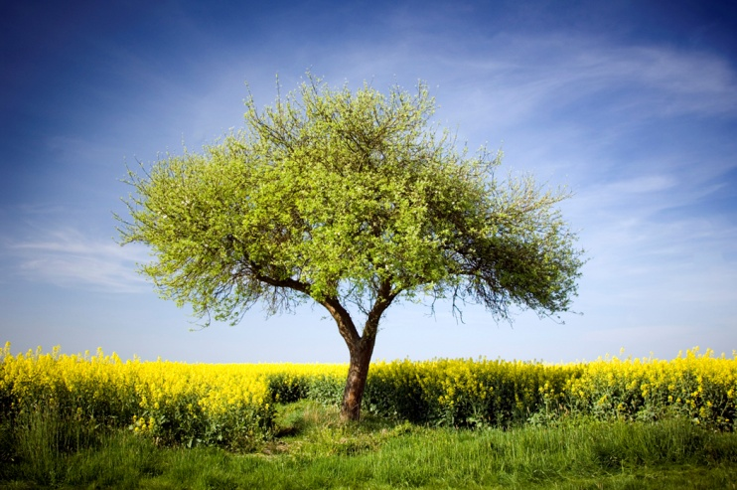
Unit A, Ch 1: Comparing Living Things Lesson 3: How are animals classified?

Slide 2
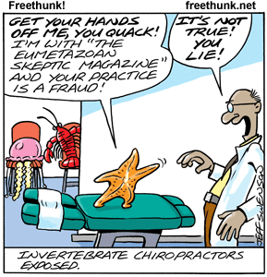
Animals without backbones
invertebrates:
An animal WITHOUT a backbone
back·boneNoun/ˈbakˌbōn/
1. The series of vertebrae extending from the skull to the pelvis; the spine.
2. The chief support of a system or organization; the mainstay

Slide 3
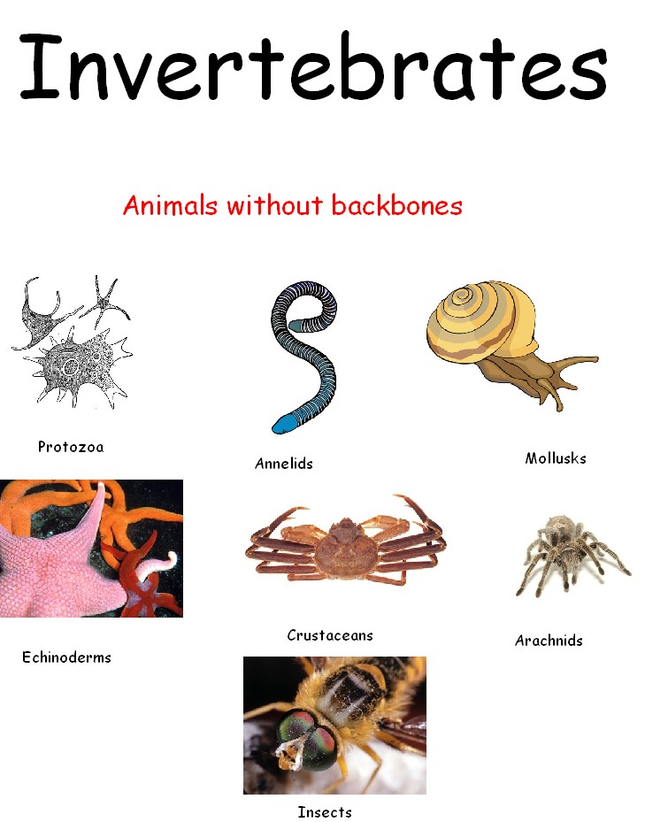
Animals without backbones
invertebrates:
An animal WITHOUT a backbone
- arthropods (80% of animals!)
EXAMPLE: sponges, snails, jellyfish, sea stars, spiders, mollusks
(70% of arthropods are insects!)

Slide 4
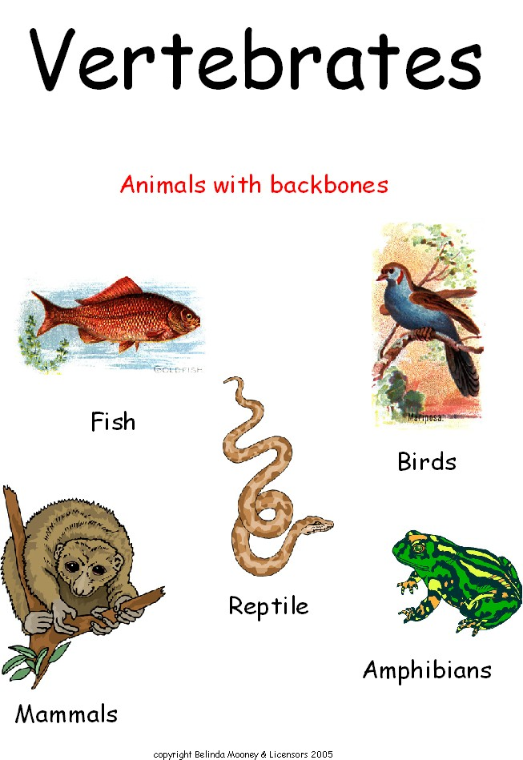
Animals with backbones
vertebrates:
An animal WITH a backbone
EXAMPLE: fish, frogs, cats, reptiles, dolphins, you!
-fish
- reptiles
- amphibians
- mammals
- birds

Slide 5
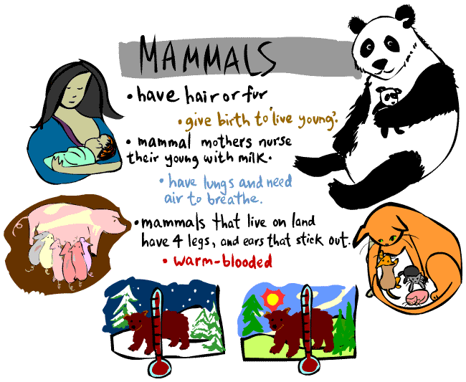
Animals with backbones
mammals:
-An animal WITH a backbone
-Have hair or fur, feed young with milk
EXAMPLE: dolphins, whales, YOU!
* Bats are the only mammals that can fly!

Slide 6
Check for Understanding…
What are invertebrates?
What are vertebrates?
What are mammals?
Can you compare and contrast the different groups of vertebrates?

