Slide 1
Unit A, Ch 1: Comparing Living Things Lesson 2: How Are Living Things Classified?

Slide 2
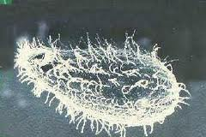
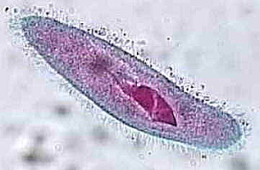
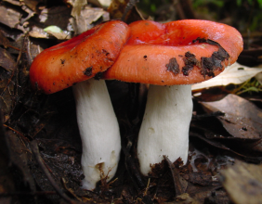
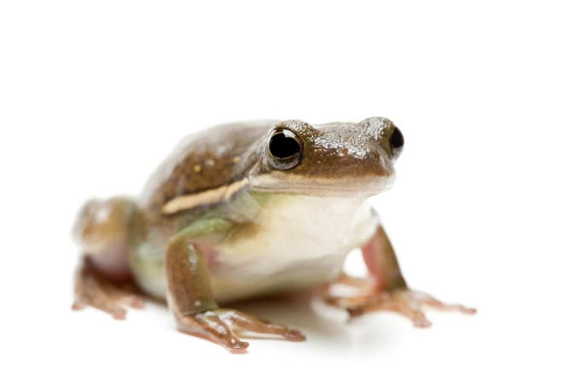
Classify “to arrange in groups using a system”
The 5 Kingdoms:
Moneran: 1-celled, no separate nucleus
EXAMPLE: bacteria
Protist: most 1-celled, have nucleus, & other cell structures EXAMPLE: ameba
Fungus: mostly many-celled, can’t move, absorb nutrients, EXAMPLES: yeast, mold, mushrooms
Plant: many-celled, cannot move, use sun’s energy,
EXAMPLE: trees, flowers, ferns
Animal: many-celled, most can move, get energy by consuming, EXAMPLE: invertebrates, fish, mammals

Slide 3
Classify “to arrange in groups using a system”
The 5 Kingdoms:
Moneran
Protist
Fungus
Plant
Animal
The 5 Kingdoms:
Money
Protested
Fungus
Planting
Animals

Slide 4
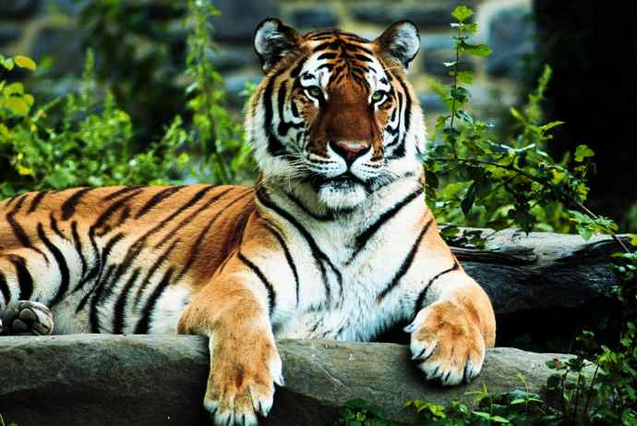
Dividing the Kingdoms into smaller groups
genus: a group of similar species
species: a group of organisms of one kind that can interbreed in nature
EXAMPLE: lions & tigers
“Large cats that roar”

Slide 5
Check for Understanding…
How do scientists classify things?
List the 5 kingdoms.
How are the 5 kingdoms divided into smaller groups?
What causes changes in scientific research?

