Slide 1
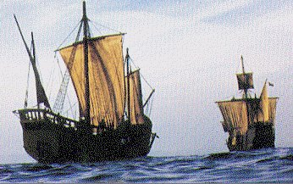
Big Ten Explorers

Slide 2
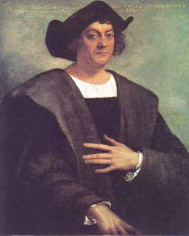
Columbus
Sailed west to Indies
Landed on the Bahamas
Sailed for Spain (King Ferdinand and Queen Isabella

Slide 3
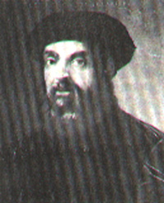
Magellan
Searched for passage to Pacific Ocean
Sailed through “straits of Magellan”
Died in Philippines
Crew lst to circumnavigate the world

Slide 4
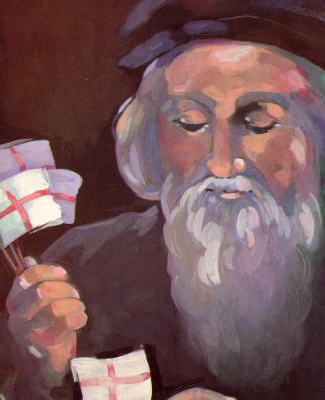
Cabot
Sailed for England
Landed on coast of New-foundland
Gave England claim to North America

Slide 5
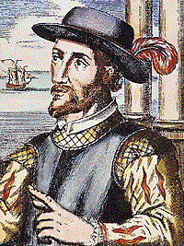
Ponce de Leon
1st to land on the mainland of North America
Looking for “fountain of youth”
Established St. Augustine, Florida

Slide 6
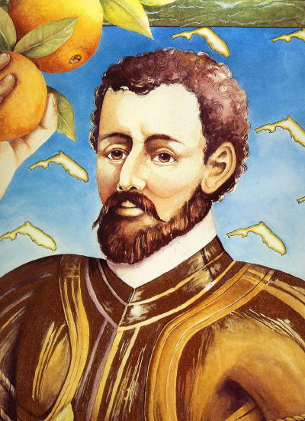
De Soto
Sailed for Spain
Explored Mississippi River – Present-day Oklahoma

Slide 7
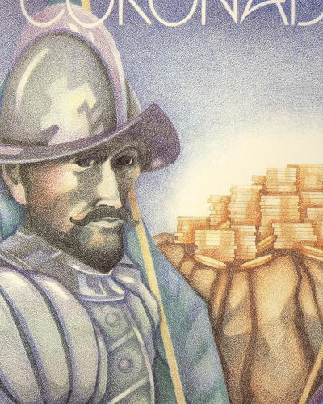
Coronado
Looking for fabled seven cities of gold
Explored present-day Arizona and New Mexico

Slide 8
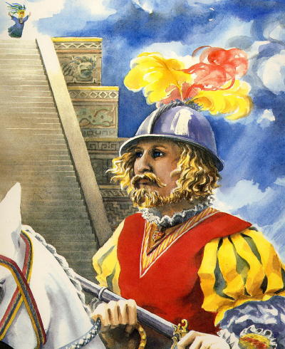
Cortes
Spanish Conquistador
Conquered Aztec emperor Montezuma

Slide 9
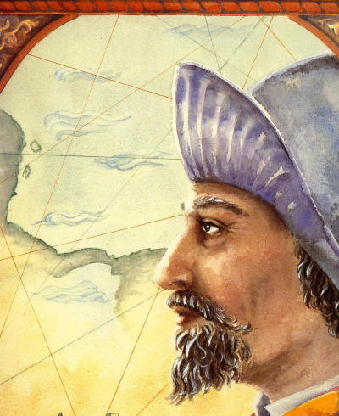
Balboa
Spanish Explorer
Claimed Pacific Ocean and adjoining lands for Spain

Slide 10
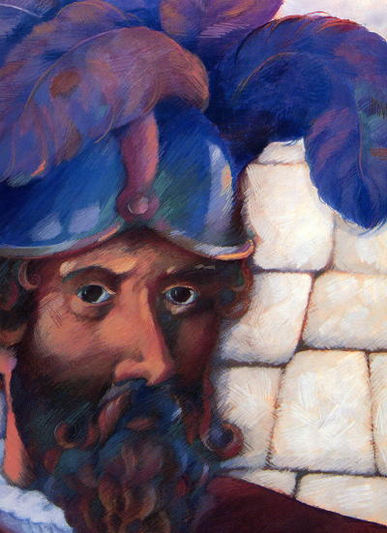
Pizzaro
Conquered the Inca Empire

Slide 11
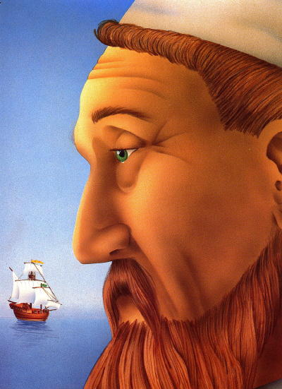
Vespucci
Amerigo Vespucci
America was named after him

Slide 12
Columbian Exchange
From America –
Corn

Slide 13
Potatoes

Slide 14
Beans

Slide 15
Chocolate

Slide 16
Buffalo

Slide 17
Beaver

Slide 18
Parrots

Slide 19
From Europe -
Oranges

Slide 20
Onion

Slide 21
Sheep

Slide 22
Horses

Slide 23
Cattle

Slide 24
Honeybees

Slide 25
Pigs

Slide 26
Chickens

Slide 27
Diseases
Small Pox

Slide 28
Influenza

Slide 29
Measles

